Slide 1
OOP
Encapsulation:
Separating an object’s state from its
behavior
Inheritance
Inheritance is the process
by which one object
acquires
the properties of another object
Polymorphism
The ability of the object in belonging to
Diff types with specific behavior
Of each type

Slide 2
Encapsulation
MyCar
Accelerate
Change gear
Brake
Brand:Ford
Speed:50mph
Gear:3th
Wheels:4
Colour: silver
allowed
Other objects
Not allowed
As

Slide 3
Inheritance
// Inheritance syntax & properties.
class Cleanser {
private String s = new String("Cleanser");
public void append(String a) { s += a; }
public void dilute() { append(" dilute()"); }
public void apply() { append(" apply()"); }
public void scrub() { append(" scrub()"); }
public void print() { System.out.println(s); }
public static void main(String[] args) {
Cleanser x = new Cleanser();
x.dilute(); x.apply(); x.scrub();
x.print();
}
}
public class Detergent extends Cleanser {
// Change a method:
public void scrub() {
append(" Detergent.scrub()");
super.scrub(); // Call base-class version
}
// Add methods to the interface:
public void foam() { append(" foam()"); }
// Test the new class:
public static void main(String[] args) {
Detergent x = new Detergent();
x.dilute();
x.apply();
x.scrub();
x.foam();
x.print();
System.out.println("Testing base class:");
Cleanser.main(args);
}
} ///:~

Slide 4
Polymorphism
class Shape {
void draw() {}
void erase() {}
}
class Circle extends Shape {
void draw() {
System.out.println("Circle.draw()");
}
void erase() {
System.out.println("Circle.erase()");
}
}
class Square extends Shape {
void draw() {
System.out.println("Square.draw()");
}
void erase() {
System.out.println("Square.erase()");
}
}
class Triangle extends Shape {
void draw() {
System.out.println("Triangle.draw()");
}
void erase() {
System.out.println("Triangle.erase()");
}
}
public class Shapes {
public static Shape randShape() {
switch((int)(Math.random() * 3)) {
default:
case 0: return new Circle();
case 1: return new Square();
case 2: return new Triangle();
Chapter 7: Polymorphism 319
}
}
public static void main(String[] args) {
Shape[] s = new Shape[9];
// Fill up the array with shapes:
for(int i = 0; i < s.length; i++)
s[i] = randShape();
// Make polymorphic method calls:
for(int i = 0; i < s.length; i++)
s[i].draw();
}
}

Slide 5
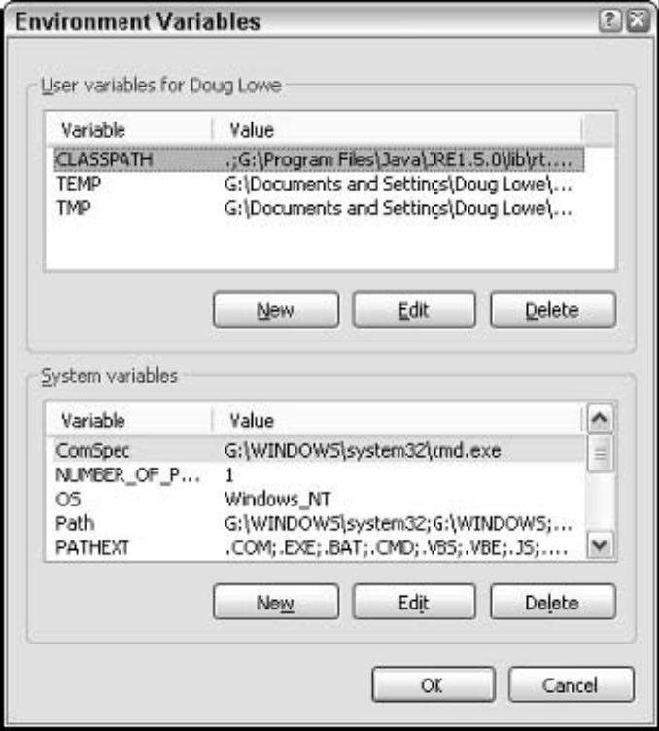
Compiling a program
Setting the path
After you install the JDK, you need to configure your operating system so
that it can find the JDK command-line tools. To do that, you must set the
Path environment variable. This variable is a list of folders that the operating
system uses to locate executable programs. To do this on Windows XP,
follow these steps:
1. Open the Control Panel and double-click the System icon.
The System Properties dialog box comes up.
2. Click the Advanced tab, and then click the Environment Variables
button.
The Environment Variables dialog box, appears.
3. In the System Variables list, select Path, and then click the Edit button.
A little dialog box comes up to let you edit the value of the Path variable.
4. Add the JDK bin folder to the beginning of the path value.
Use a semicolon to separate the bin folder from the rest of the information
that may already be in the path. Note: The exact name of the bin
folder may vary on your system. For example:
c:\Program Files\Java\jdk1.5.0\bin;other
directories...

Slide 6
Compiling a program
You can compile a program from a command prompt by using the javac
command. Before you can do that, however, you need a program to compile.
Using any text editor, type the following text into a file and save it as
HelloApp.java:
public class HelloApp
{
public static void main(String[] args)
{
System.out.println(“Hello, World!”);
}
}
Save the file in any directory you wish. Pay special attention to capitalization.
For example, if you type Public instead of public, the program won’t
work. (If you don’t want to bother with the typing, you can download the
sample programs from this book’s Web site.)
Open a command prompt and use a cd command to change to the directory
you saved the program file in. Then enter the command javac HelloApp.
java. This command compiles the program (javac) and creates a class file
named HelloApp.class.

Slide 7
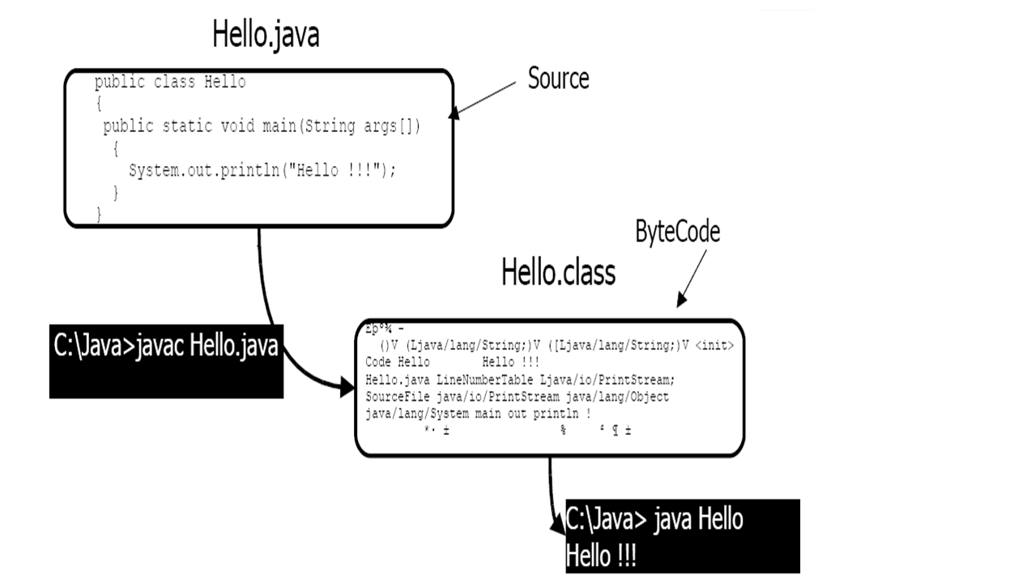

Slide 8
ArrayList
The ArrayList class extends AbstractList and implements the List interface.
ArrayList supports dynamic arrays that can grow as needed. In Java, standard arrays are of a fixed length.
After arrays are created, they cannot grow or shrink, which means that you must know in advance how many elements an array will hold.
But, sometimes, you may not know until run time precisely how large of an array you need. To handle this situation, the collections framework defines ArrayList.
In essence, an ArrayList is a variable-length array of object references.
That is, an ArrayList can dynamically increase or decrease in size. Array lists are created with an initial size. When this size is exceeded, the collection is automatically enlarged. When objects are removed, the array may be shrunk.

Slide 9
ArrayList has the constructors shown here:
ArrayList( )
ArrayList(Collection c)
ArrayList(int capacity)
The first constructor builds an empty array list.
The second constructor builds an array list that is initialized with the elements of the collection c.
The third constructor builds an array list that has the specified initial capacity. The capacity is the size of the underlying array that is used to store the elements. The capacity grows automatically as elements are added to an array list.
The following program shows a simple use of ArrayList. An array list is created, and then objects of type String are added to it. (a quoted string is translated into a String object.) The list is then displayed. Some of the elements are removed and the list is displayed again.

Slide 10
// Demonstrate ArrayList.
import java.util.*;
class ArrayListDemo {
public static void main(String args[]) {
// create an array list
ArrayList al = new ArrayList();
System.out.println("Initial size of al: " + al.size());
// add elements to the array list
al.add("C");
al.add("A");
al.add("E");
al.add("B");
al.add("D");
al.add("F");
al.add(1, "A2");
System.out.println("Size of al after additions: " + al.size());
// display the array list
System.out.println("Contents of al: " + al);
// Remove elements from the array list
al.remove("F");
al.remove(2);
System.out.println("Size of al after deletions: " + al.size());
System.out.println("Contents of al: " + al);
}
}
The output from this program is shown here:
Initial size of al: 0
Size of al after additions: 7
Contents of al: [C, A2, A, E, B, D, F]
Size of al after deletions: 5
Contents of al: [C, A2, E, B, D]

